Slide 1

Krypto_Boyz
Final group presentation

Slide 2
Table of Contents
Part 1: Honeypot
Project Description
Problem Analysis and Research
Implementation Process
Red vs Blue Results
Live Demo
Conclusion
Part 2: Pentest
Assignment Context
Pentesting Process
Conclusion

Slide 3
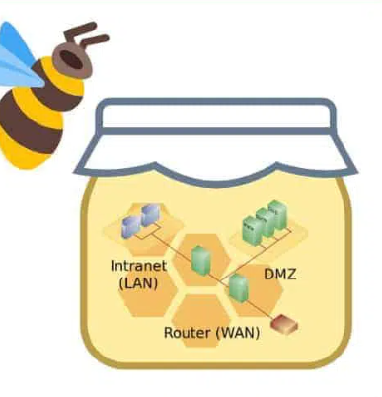
Honeypot: Project Description
Research: What are the most effective strategies for deploying and managing honeypots to maximize their utility in detecting and preventing cyber threats?
What are the needed components and requirements for creating a honeypot?
What are the different types of honeypots, and how do they differ in deployment and management?
How do we monitor and analyze honeypot data to identify and respond to security threats?
What is a viable network infrastructure to successfully mimic a company?
What are design conventions for online trading platforms that can be implemented in a honeypot for a more believable application?

Slide 4
What research strategies and Methods de we use ?
- Why
- What
Looking at honeypot designs and how we can mimic a production environment
- How
Library research and workshop research by looking at premade honeypots and looking at the structure of a company
maximize our ability in detecting and preventing cyber threats?
DOT framework

Slide 5

Honeypot: Problem Analysis and Research
Identify requirements/wishes with client
Comparing existing crypto platforms
Researching high vs low interaction
What data needs to be monitored

Slide 6

Why we chose this idea and how it works
The idea of crypto seems to gain interests of malicious actors.
Development environment leak
The traffic that this site would gain has great educational value
An ethical way to monitor attack techniques
The attacker stumbles upon the webpage and after some investigation they see a crypto webpage that is still under development after snooping around they find a vulnerable login page and with SQLi they can exploit get some passwords and possibly SSH into the backend.

Slide 7
Results and findings
Attackers try and brute force many simple credentials eg. Root root
NMAP scans trying to map out the network for more entry points
There are many automated scripts that are used to try brute force SSH credentials.
Attempts to figure out what host system they’re on (installing neofetch/fastfetch)

Slide 8

Security
Firewall rules to block communication to our monitoring vlan
Access blocked to both firewalls and can only be managed through 1 machine
NMAP detection + SQL attacks + path traversal monitored

Slide 9
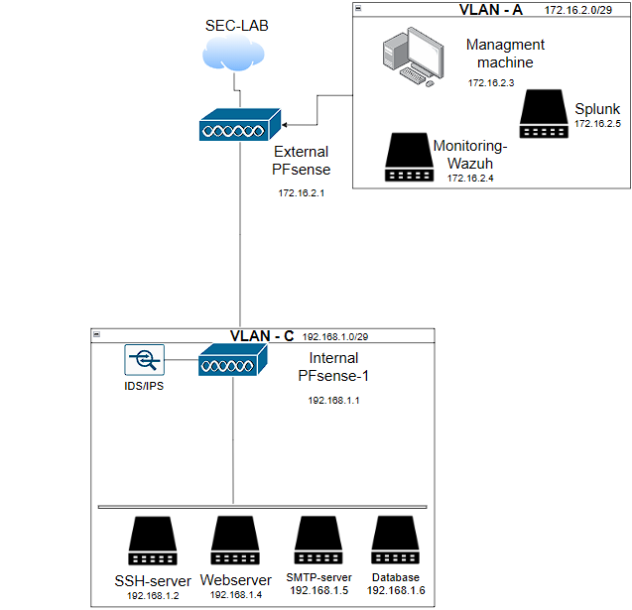
Honeypot: Implementation Process
Research what are honey pots
Design ideas to gain attraction to honeypot
Come up with a plausible infrastructure
Create servers
Configure the machines

Slide 10

Honeypot: Red vs Blue Results
SQL; Filtering spaces & special characters
Scanning and enumeration incl. WAF
XSS
Path traversal

Slide 11

Honeypot: Live Demo

Slide 12

Honeypot: Conclusion
Any Questions?

Slide 13

Pentest: Assignment Context
Educational Foundation Triade
On location at Basisschool De Driesprong
May 13th to May 15th
Two days on location, one day remote

Slide 14
Pentest: Process
Day 1: Basisschool De Driesprong
General reconnaissance
Day 2: Split between same location and office
Phishing campaign sent out
Day 3: Pentesting remotely and project wrap-up
Completing report

Slide 15
Pentest: Conclusion
Report handed in on May 24th
Project finalized June 3rd
Simplified version of report also provided
Any Questions?

